Slide 1

Leadership Skills
…for Shared Ministry

Slide 2
Our Purpose Today
Confidence to lead at FUUN
Increased skill in carrying out your group’s mission
Making volunteering fun

Slide 3
What Is Shared Ministry?
Partnership between staff, volunteers
We operate with paid and volunteer staff
Who’s accountable?
Notes:
While it takes all of us, it is staff that ultimately ends up being responsible for most things. Volunteers take direction from staff.

Slide 4
What makes a Good Leader?
Has a vision for the team
Sets and meets goals
Makes room for different viewpoints
Creates welcoming atmosphere
Builds trust
Develops others
Notes:
Ask ptpts what makes a good leader, create their list on flip chart. Key off those or these items to discuss how to do those things.

Slide 5
During this session…
Building your work group
Tools you need
Managing meetings
Communication

Slide 6
Building Your Work Group
Your charge
Inviting volunteers
Understanding what team members want
Setting goals around your mission

Slide 7
Committee and Task Force Charges
https://www.thefuun.org/committee-charges/
First Unitarian Universalist Church of Nashville
Committee Charge
Council: Resources and Development Adopted: January 17, 2017
Revised: May 16, 2017
LEADERSHIP DEVELOPMENT COMMITTEE
Purpose:
The Leadership Development Committee's purpose is to support, train, and guide members to participate in leadership in the church to the mutual benefit of the individual and the congregation.
Charge:
The Leadership Development Committee is charged to support the creation of a culture of leadership development at FUUN.
The Leadership Development Committee is responsible for:
Advocating when needed for organizational, budgetary, and cultural changes that improve our leadership structure…
Notes:
On the website

Slide 8
Building Your Work Group
Your charge
Inviting volunteers
Understanding what team members want
Setting goals around your mission

Slide 9
Inviting Volunteers
Connection to Ministry Goals
Why you are inviting this particular person
Benefits for the volunteer
Position Description
Notes:
Hand out. Each step has underlying assumptions: Your committee is actually serving broader goals of our mission; you’ve talked to this person and have a sense of the skills and attributes they would be bringing, as well as their interests; you have a position description of the activity you want them to undertake. After going over this, break them in pairs and have them try their hand at it for their own committee/task force/project
Connection to Ministry Goals
Explain how the particular position relates to the mission of the church, the ministry goals of the congregation, ministry area, council, committee group, or to the Southern Region or UUA. Why is this ministry important? What difference does it really make? What new directions are being taken or challenges are being met?
Why you are inviting this particular person
Explain specifically why you are inviting this special, unique person to this particular position of ministry, identify the skills, interests, vision, personality, attitudes, values or experiences this member has that makes him or her just right for this ministry position.
Benefits for the volunteer
Describe some benefits the volunteer might receive from accepting this position of service. These may relate to the specific gifts of the person involved or things others have enjoyed or valued in this position. The more personal you can be the better.
Position Description
Explain briefly the elements of the position, including major responsibilities, expected amount of time involved, length of commitment, and days of the week or month when the service is to be done. If there are expectations for training, explain them. This message is best communicated by including the printed position description.

Slide 10
Building Your Work Group
Your charge
Inviting volunteers
Understanding what team members want
Setting goals around your mission

Slide 11
Why Do People Join Committees?
To help others
Social interaction
Enjoy the work
Ask your team
Notes:
Hand out. Each step has underlying assumptions: Your committee is actually serving broader goals of our mission; you’ve talked to this person and have a sense of the skills and attributes they would be bringing, as well as their interests; you have a position description of the activity you want them to undertake. After going over this, break them in pairs and have them try their hand at it for their own committee/task force/project
Connection to Ministry Goals
Explain how the particular position relates to the mission of the church, the ministry goals of the congregation, ministry area, council, committee group, or to the Southern Region or UUA. Why is this ministry important? What difference does it really make? What new directions are being taken or challenges are being met?
Why you are inviting this particular person
Explain specifically why you are inviting this special, unique person to this particular position of ministry, identify the skills, interests, vision, personality, attitudes, values or experiences this member has that makes him or her just right for this ministry position.
Benefits for the volunteer
Describe some benefits the volunteer might receive from accepting this position of service. These may relate to the specific gifts of the person involved or things others have enjoyed or valued in this position. The more personal you can be the better.
Position Description
Explain briefly the elements of the position, including major responsibilities, expected amount of time involved, length of commitment, and days of the week or month when the service is to be done. If there are expectations for training, explain them. This message is best communicated by including the printed position description.

Slide 12
Building Your Work Group
Your charge
Inviting volunteers
Understanding what team members want
Setting goals around your mission

Slide 13
Goal Setting
Annual Retreat
Based on charge
Input from?
Measureable
Responsibility
Part of every agenda
Notes:
Annual Retreat—late summer is often a good time for the retreat. Sets the tone for the rest of the year
Based on charge—What is your team supposed to be doing for FUUN?
Input from?—Who can provide insights into what is needed? Staff liaison? Council chair? Past committee chair? Members?
Measureable—What’s to be accomplished by when? Break down into tasks
Responsibility—specifically, who is responsible for each task?
Part of every agenda—Progress report/successes/troubles?

Slide 14
Tools You Need
Leadership Orientation
Members Area
  https://www.thefuun.org/members-area/

Slide 15
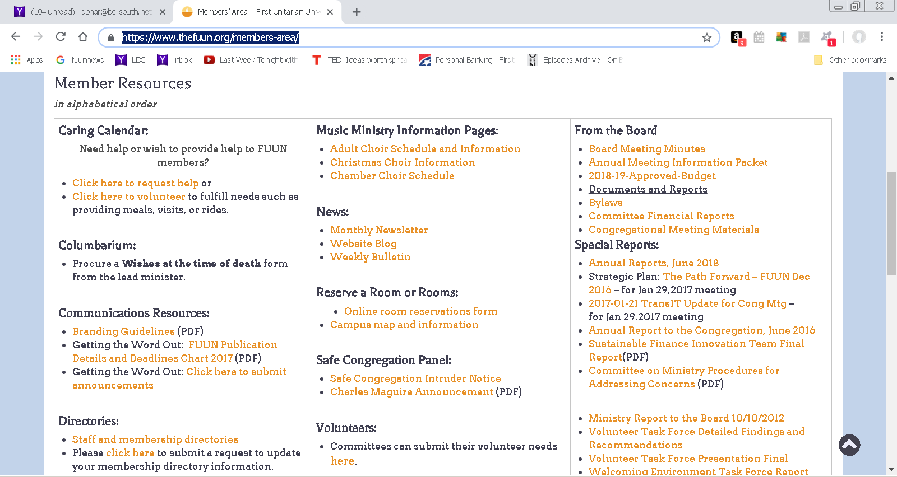
Notes:
Go to “Members Area” and find “Documents, Resources, and Reports”

Slide 16
Tools You Need
Leadership Orientation
Members Area
Office Administrator
Council Chair
Leadership Development Team

Slide 17
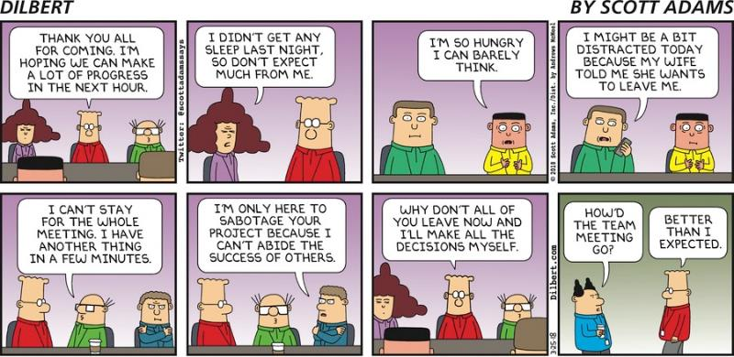
Meeting Management

Slide 18

You've just left a meeting feeling really good.
What happened to make you feel that way?
Notes:
Capture on flipchart (+)

Slide 19

You've just left a meeting feeling really frustrated.
What happened to make you feel that way?
Notes:
Capture on flip chart (-)

Slide 20
Managing Meetings
Covenants
Agendas
Notes
Hearing all viewpoints
Decision making
Delegating
Process observation

Slide 21
COVENANT OF THE COMMITTEE FOR THE LARGER FAITH
Adopted October 2018
We members of the Committee for the Larger Faith covenant with one another to:
treat one another with loving respect
treat one another's ideas with respect, seeking the merit in each
be mindful of those who may not be represented in our group, but who deserve our understanding of their perspectives
honor the work our committee is charged to carry out, by attendance at our meetings and following through on any assignments we have undertaken
bring our whole selves to our work, participating fully to the best of our abilities

Slide 22
Managing Meetings
Covenants
Agendas
Notes
Hearing all viewpoints
Decision making
Delegating
Process observation

Slide 23
LEADERSHIP DEVELOPMENT COMMITTEE
NOVEMBER 21, 2017
CLASSROOM A AND ZOOM
AGENDA
Time Keeper/Process Observer: Debbie Notes: Sharon
6:00 | Opening reading and check in: Pat
6:10 | ACTION ITEMS from October: Ask Beloved Community to attend November meeting: Gail Rob and Gail get together to talk about emotional dynamics of change Everybody like church Facebook page. Debbie, Rob, and Gail look at the powerpoint on effective meetings . Sharon and Gail meeting Monday Oct 23 to finalize DISC class. Sharon will look for online tutorials for online tools Debbie and Gail: add brainstorm recommendations for new member class to November agenda | I
6:15 | Beloved community and Leadership Development: Gail, Emily, Carleen | Di
6:30 | Brainstorm recommendations for new member class: Pat | Di
6:45 | DiSC training: Sharon | I
6:50 | Workshops on change: Gail and Rob | I
7:00 | Leadership toolbox: Sharon | Di
7:10 | Meeting night: Mondays? Tuesdays? | De
7:15 | Recap action items: Pat
7:20 | Process observation: Debbie
7:25 | Adjourn

Slide 24
Managing Meetings
Covenants
Agendas
Notes
Hearing all viewpoints
Decision making
Delegating
Process observation

Slide 25
Notes
Designated note taker—not the leader
During the meeting—flipcharts are great
  Allow all to both see and hear
  Help keep conversation on topic
  Reduce repetition
After the meeting
  Distribute within the week
  Include all action items and person responsible
  Include action items in body of email

Slide 26
Managing Meetings
Covenants
Agendas
Notes
Hearing all viewpoints
Decision making
Delegating
Process observation

Slide 27
Hearing all Viewpoints
Don’t rush to a conclusion
Invite all to talk
Use a flip chart
Model respect for ideas and viewpoints

Slide 28
Managing Meetings
Covenants
Agendas
Notes
Hearing all viewpoints
Decision making
Delegating
Process observation

Slide 29
Making Decisions
Consensus: All are heard
Single vote/Multiple votes/weighted votes

Slide 30
Managing Meetings
Covenants
Agendas
Notes
Hearing all viewpoints
Decision making
Delegating
Process observation

Slide 31
Delegating
Elements of the meeting
Tasks between meetings
Project leading

Slide 32
Managing Meetings
Covenants
Agendas
Notes
Hearing all viewpoints
Decision making
Delegating
Process observation

Slide 33
One Process Observation Form
Did the meeting start on time; were all participants there on time?
Was the agenda followed? Did the group avoid getting off track?
Was there mechanism for tracking on last meeting's actions?
Did everyone participate? Did anyone dominate the conversation? Were quieter ones drawn into the conversation?
Did participants avoid interrupting one another? Was side-talking minimal?
If there were disagreements, were they handled respectfully? Were people encouraged to present dissenting views?
Was there a clear process for making decisions? Once decisions were made, was responsibility for further action clarified and assigned?
Was there room for fellowship and good humor?
(What other elements of your covenant should be included?)

Slide 34
Communication
During meetings
  Look for signs of understanding
  Give quiet people a chance to be heard
Between meetings
  Notes from last meeting with action items
  Mid-month follow-up
  Prep for next meeting/call for agenda items
Different styles for different people
  Email
  Social media
  Text
  Phone call

Slide 35
Want More Help?
Contact the Leadership Development Team at FUUNlead@thefuun.org

Slide 36
Thank You!

